Slide 1


Man-in-the-Middle Attacks
SAKSHI MAHADEV KAMBLE BCA - CFIS 3SEM

Slide 2

Man-in-the-Middle Attacks
Man-in-the-middle attacks are a type of cyber-attack where the attacker intercepts communication between two parties to spy on them or alter the communication. Let's explore how they work and ways to prevent them.

Slide 3

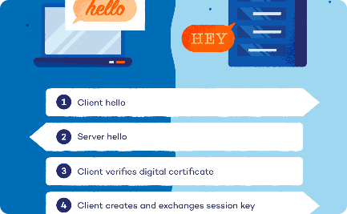

Understanding the Attack
How it Works
Encryption Keys
Types of Attacks
In a man-in-the-middle attack, the attacker intercepts the communication between two unsuspecting parties. They can then eavesdrop or manipulate the conversation in real-time.
Attackers can use stolen encryption keys to decrypt and view messages originally intended to be private, including sensitive information such as passwords.
There are several types of man-in-the-middle attacks including IP spoofing, ARP spoofing, and SSL stripping, amongst others.

Slide 4

Real-World Examples
1
Email Scam
Cybercriminals can intercept emails and reply with malicious intent. A common example is scammers posing as someone else requesting for personal information.
2
Public Wi-Fi
Attackers can set up bogus wireless access points to lure unsuspecting users into connecting to the rogue hotspot and hence intercept their communication.
3
ATM Scam
Attackers can place a device that alters data between the card reader and the bank's server, thereby stealing your card details and PIN when you withdraw cash.

Slide 5
Preventing Man-in-the-Middle Attacks
Encryption
Two-Factor Authentication
VPN
Use encryption to protect your data. It ensures that any data sent over the internet is scrambled and only properly decrypted by the recipient.
Use a virtual private network (VPN) as it encrypts your communication and hides your location from attackers.
Use two-factor authentication whenever possible. This adds another layer of security that is often immune to man-in-the-middle attacks.

Slide 6
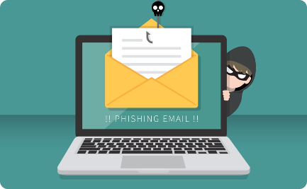
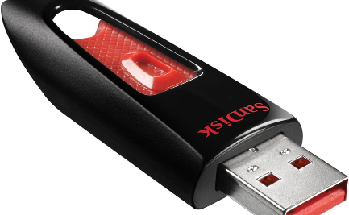

The Human Factor
Phishing Emails
USB Attacks
Training
Attackers often use phishing emails to trick unsuspecting victims into willingly giving out their personal information or passwords.
Attackers can infect a USB device with malware or viruses, and anyone who plugs that USB into their computer risks infecting it.
Train employees on how to identify phishing emails and other types of social engineering attacks. This awareness can significantly reduce the risk of man-in-the-middle attacks.

Slide 7
Conclusion
1
Stay Vigilant
2
Constant Learning
Defend against man-in-the-middle attacks by staying informed of the latest threats and using a combination of security measures.
Cybersecurity is an ever-evolving field, so it's essential to keep learning and adapting.

